Slide 1
Capstone Project-3
Credit Card Default Prediction Submitted by- Rinkesh Das Data Science Trainee, Almabetter Cohort Kaimur

Slide 2
Outline
Problem Statement
Data Description
Data Cleaning
Exploratory Data Analysis (EDA)
SMOTE
Model Training and Implementation
Model Evaluation
Model Validation
Challenges faced

Slide 3
Credit Card Default
A credit card is a payment card issued to users (cardholders) to enable the cardholder to pay a merchant for goods and services based on the cardholder's accrued debt (i.e., promise to the card issuer to pay them for the amounts plus the other agreed charges). The payment can be made either in a one-time-mode or in the form of monthly installments.
Credit card default happens when you have become severely delinquent on your credit card payments. Missing credit card payments once or twice does not count as a default. A payment default usually occurs when you fail to pay the Minimum Amount Due on the credit card for 6 consecutive months.
In case of a credit card payment default, the banks have to go through unnecessary trouble and banks are not willing to do so.

Slide 4
Problem Statement
Prediction of the possibility of the user to default on his/her credit card payment next month.
Analysis of the factors that determine the possibility of the user defaulting the payment.
Help the bank identify all the potential defaulters beforehand.
Objective
This project aims at building a machine learning model that predicts the possibility of the user to default on his/her credit card payment next month. For this, relevant data is provided to the model which shows how the defaulting depends on other factors. The model studies the pattern of dependency that the data follows and predicts the future but it is not necessarily true.

Slide 5
Data Cleaning
Data Analysis
Model Training
Observing the dataset.
Getting information about the columns and their data types.
Checking and removing the null and duplicated values from the dataset.
Examining the patterns of distribution and relations between variables through various plots.
Performing Univariate and Bivariate Analysis
Getting inference from those plots and processing the data accordingly.
Training machine learning models on the dataset.
Testing the performance of the models on the test dataset.
Validating the models with the use of metrics.

Slide 6
Data Description
Attribute Information:
This research employed a binary variable, default payment (Yes = 1, No = 0), as the response variable. This study reviewed the literature and used the following 23 variables as explanatory variables:
X1: Amount of the given credit (NT dollar): it includes both the individual consumer credit and his/her family (supplementary) credit.
X2: Gender (1 = male; 2 = female).
X3: Education (1 = graduate school; 2 = university; 3 = high school; 4 = others).
X4: Marital status (1 = married; 2 = single; 3 = others).
X5: Age (year).
X6 - X11: History of past payment. We tracked the past monthly payment records (from April to September, 2005) as follows: X6 = the repayment status in September, 2005;

Slide 7
Data Description
X7 = the repayment status in August, 2005; . . .;X11 = the repayment status in April, 2005. The measurement scale for the repayment status is: -1 = pay duly; 1 = payment delay for one month; 2 = payment delay for two months; . . .; 8 = payment delay for eight months; 9 = payment delay for nine months and above.
X12-X17: Amount of bill statement (NT dollar). X12 = amount of bill statement in September, 2005; X13 = amount of bill statement in August, 2005; . . .; X17 = amount of bill statement in April, 2005.
X18-X23: Amount of previous payment (NT dollar). X18 = amount paid in September, 2005; X19 = amount paid in August, 2005; . . .;X23 = amount paid in April, 2005.

Slide 8
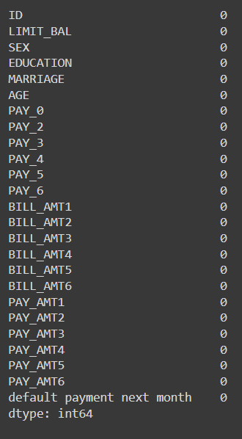
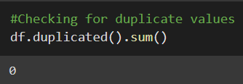
Data Cleaning
The dataset contains 30000 rows and 25 columns.
All the features are numerical features.
The dataset does not contain any null or duplicate values.

Slide 9
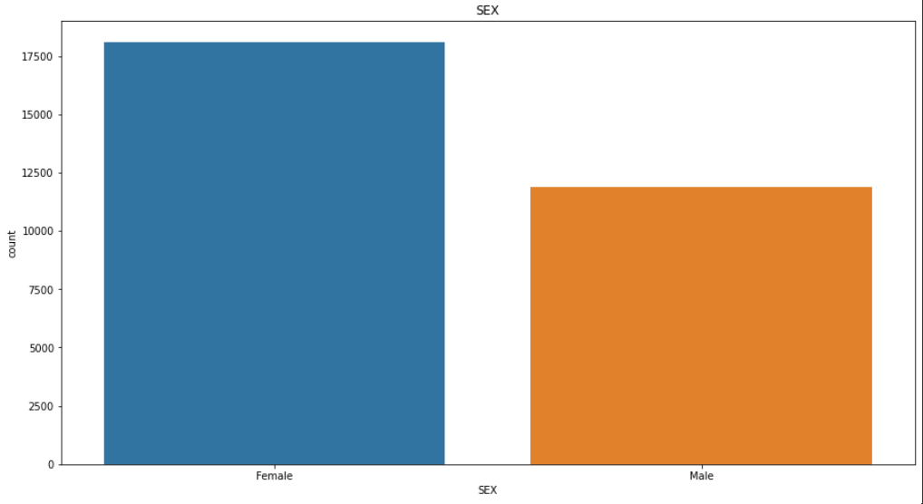
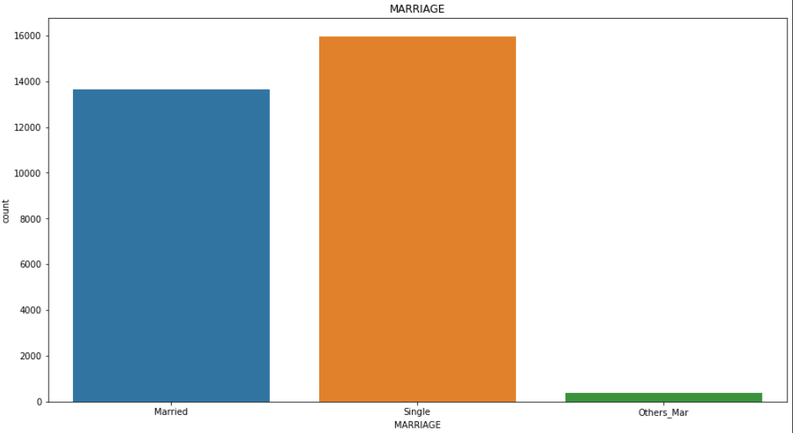
Exploratory Data Analysis (EDA)
Univariate Analysis
SEX
It is observed that the number of females that use credit cards is more than that of males.
MARRIAGE
It is observed that single people use credit card more than others.

Slide 10
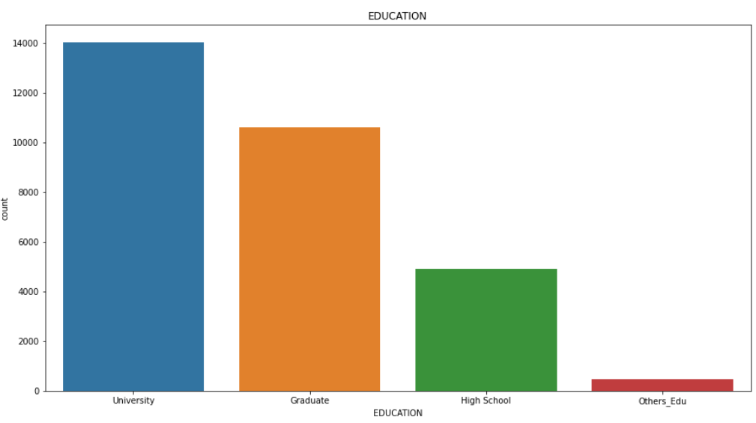
Exploratory Data Analysis (EDA)
Univariate Analysis
EDUCATION
It is observed that majority of the credit card users have received University level education.

Slide 11
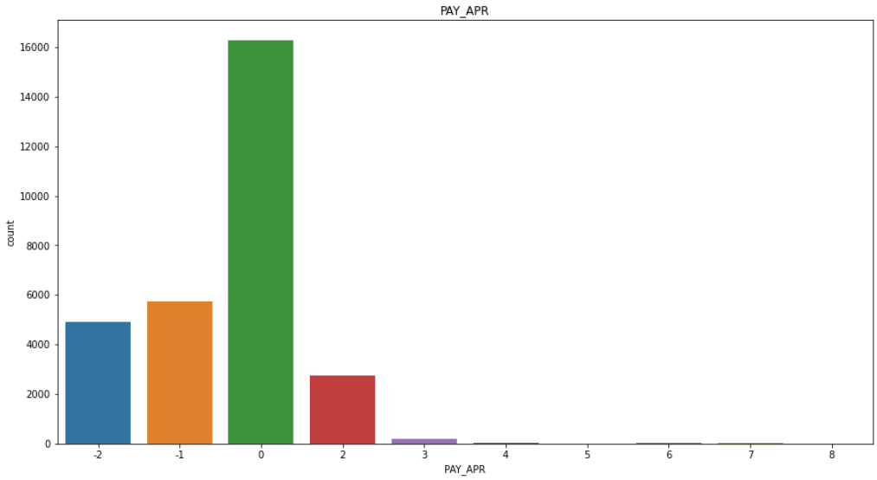
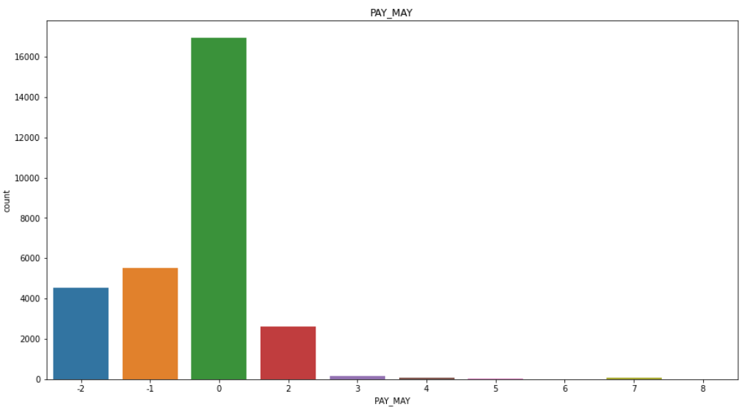
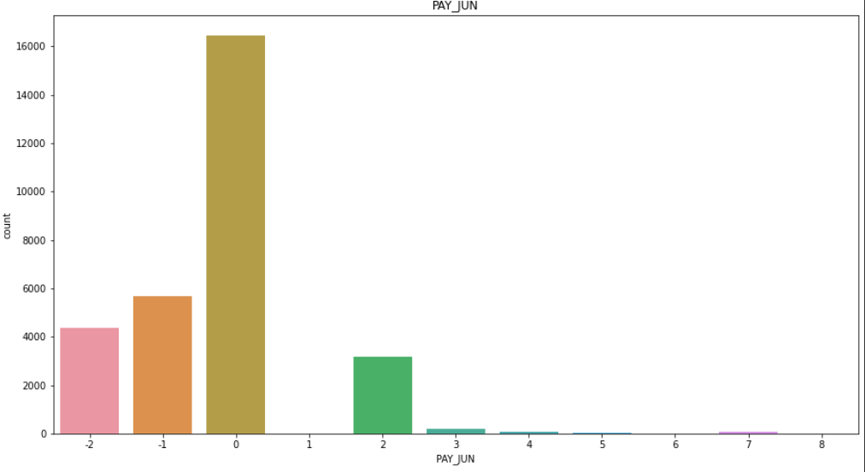
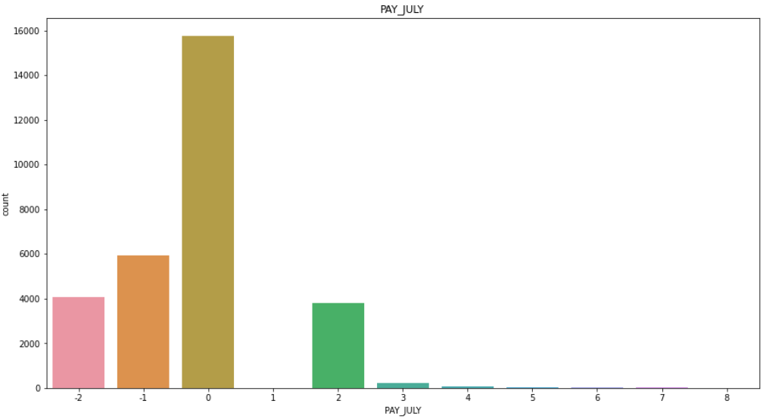
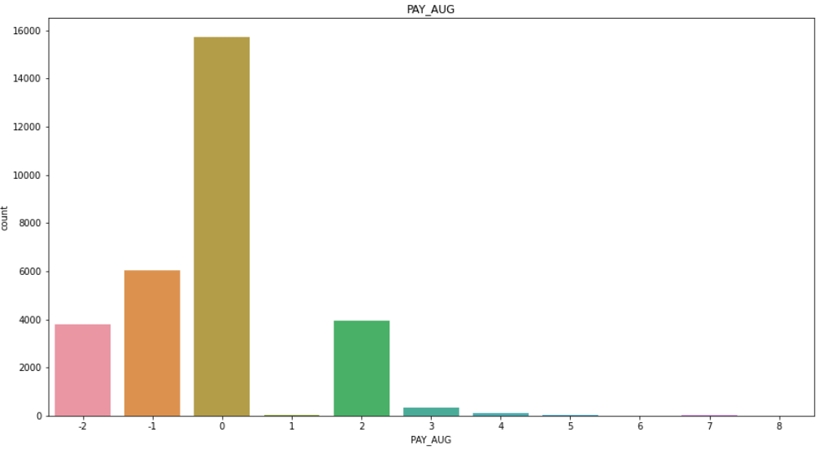
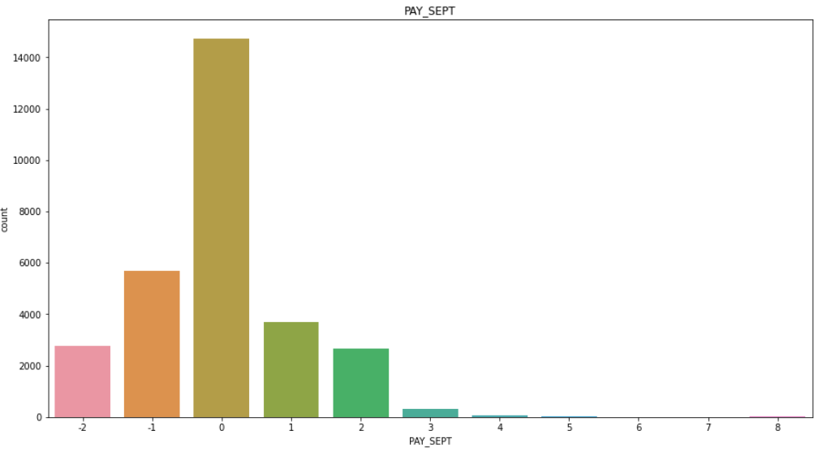
Exploratory Data Analysis (EDA)

Slide 12
Exploratory Data Analysis (EDA)
Univariate Analysis
LAST 6 MONTHS PAYMENT
It is observed that most of the users have paid their last six month dues on time.

Slide 13
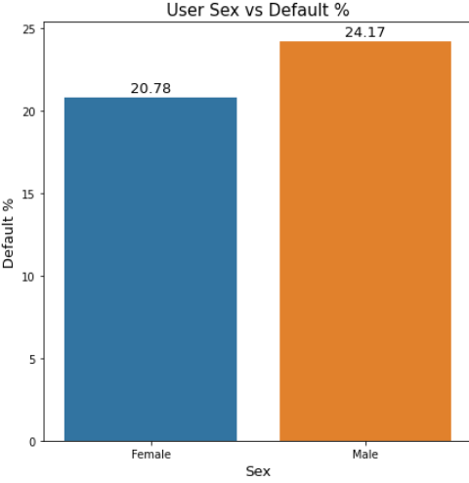
Exploratory Data Analysis (EDA)
Bivariate Analysis
DEFAULT % W.R.T. SEX OF THE USER
It is observed that female users have a default% of 20.78% against 24.17% default % of male users.
This suggests that males tend to default on their credit card payments more than females.

Slide 14
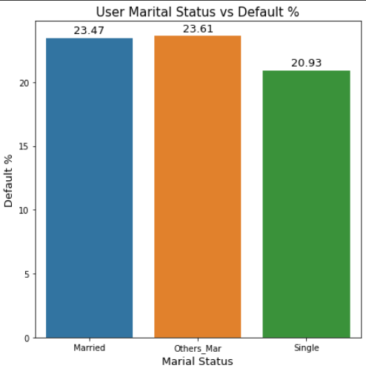
Exploratory Data Analysis (EDA)
Bivariate Analysis
DEFAULT % W.R.T. MARITAL STATUS OF THE USER
It is observed that married users have a default% of 23.47% against 20.93% default % of singles.
This suggests that married users tend to default on their credit card payments more than others.

Slide 15
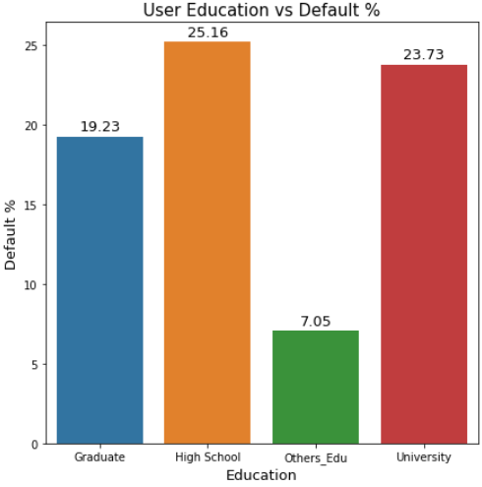
Exploratory Data Analysis (EDA)
Bivariate Analysis
DEFAULT % W.R.T. EDUCATION OF THE USER
It is observed that high school passouts have a default% of 25.16% against 23.73% and 19.23% default % of University passouts and graduates.
This suggests that users who have studied till high school level tend to default on their credit card payments more than others.

Slide 16
Conclusions after EDA
The number of females that use credit cards is more than that of males.
Single people use credit card more than others.
Majority of the credit card users have received University level education
Most of the users have paid their last six month dues on time.
Males tend to default on their credit card payments more than females.
Married users tend to default on their credit card payments more than others.
The users who have studied till high school level tend to default on their credit card payments more than others.

Slide 17
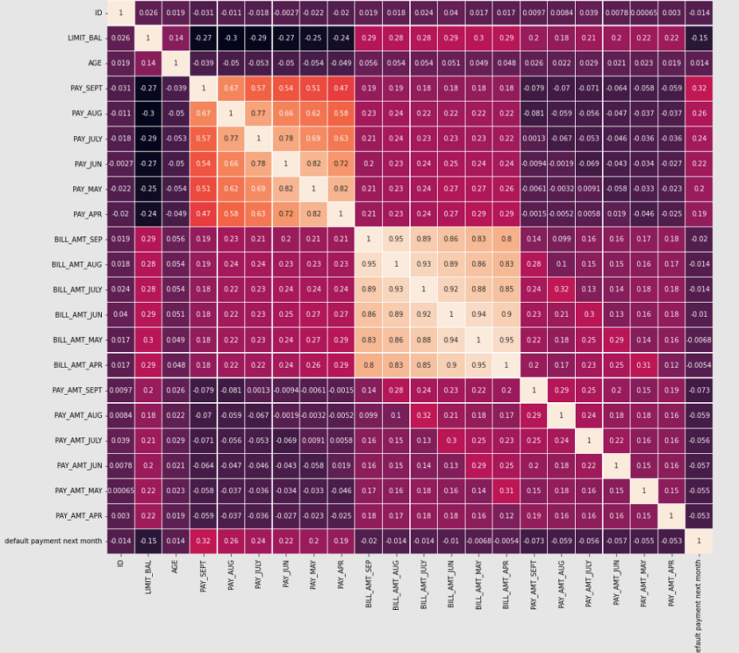
Correlation among variables

Slide 18
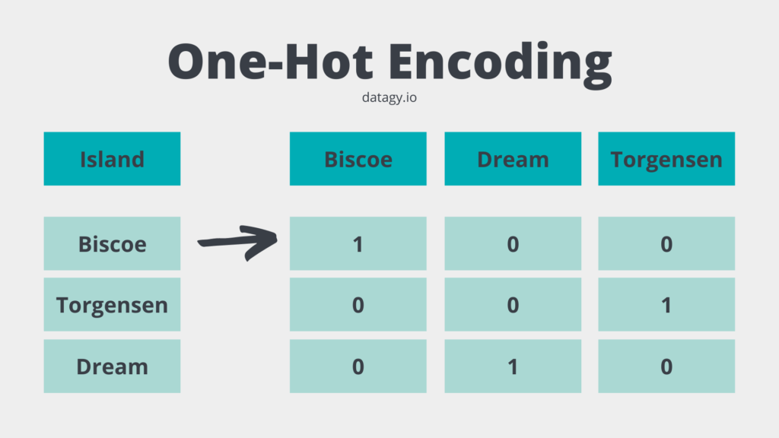
One Hot Encoding
One hot encoding algorithm is an encoding system of Sci-kit learn library. One Hot Encoding is used to convert numerical categorical variables into binary vectors.
The categorical variables in the dataset were encoded.
Finally, we had a dataset which consisted of 84 columns.

Slide 19

SMOTE
Synthetic Minority Oversampling Technique or SMOTE is a type of data augmentation approach that involves synthesizing new examples from the existing minority examples or in simple words, oversampling the minority class.

Slide 20
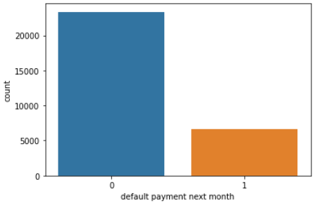
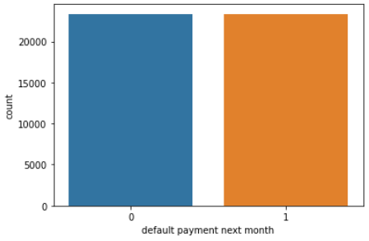
SMOTE
It was observed that the dataset was highly imbalanced with 23364 and 6336 values for each of the class.
So SMOTE was applied.
After the oversampling the number of values in both the classes was 23364.
Before
After

Slide 21
Model Training and Implementation
Models used for training
Logistic Regression
Random Forest Classifier
Gaussian Naïve Bayes
XG Boost
Decision Tree Classifier
KNN
SVC
Metrics used for evaluation
Accuracy Score
Precision Score
Recall Score
F1 Score

Slide 22
Model Evaluation
Model Performance on the train dataset
Model | Accuracy | Precision | Recall Score | F1 Score
Logistic Regression | 0.626906 | 0.604835 | 0.714836 | 0.656367
Random Forest | 1.000000 | 1.000000 | 1.000000 | 1.000000
Gaussian Naïve Bayes | 0.600637 | 0.556115 | 0.909315 | 0.690151
XG Boost | 1.000000 | 1.000000 | 1.000000 | 1.000000
Decision Tree Classifier | 0.954925 | 0.962192 | 0.947675 | 0.954879
KNN | 1.000000 | 1.000000 | 1.000000 | 1.000000
SVC | 0.653603 | 0.615967 | 0.804933 | 0.697885

Slide 23
Model Evaluation
Model Performance on the test dataset
Model | Accuracy | Precision | Recall Score | F1 Score
Logistic Regression | 0.624438 | 0.604756 | 0.718382 | 0.656690
Random Forest | 0.845388 | 0.859626 | 0.825594 | 0.842266
Gaussian Naïve Bayes | 0.591697 | 0.556300 | 0.906056 | 0.689352
XG Boost | 0.862615 | 0.872336 | 0.849561 | 0.860798
Decision Tree Classifier | 0.751979 | 0.751549 | 0.752835 | 0.752192
KNN | 0.822170 | 0.761508 | 0.938155 | 0.840652
SVC | 0.642949 | 0.608901 | 0.799272 | 0.691219

Slide 24
Model Validation
While validating the models more importance should be given to 'recall scores' since the priority of the banks is to identify a potential defaulter. Whereas if a user is wrongly detected as a potential defaulter there will not be much problem.
Some of the models perform bad on both the train and test data. (Logistic Regression, SVC). They seem to be underfitting the train data.
Some of the models perform good on train data but not so good on the train data. (Decision Tree Classifier). They seem to be overfitting the train data.
Random Forest, XG Boost, Gaussian Naïve Bayes gives us decent recall scores that are 0.82, 0.84, 0.89 respectively. Whereas KNN gives a very good recall score of 0.94.
So we can select KNN as the optimum model for our problem statement.

Slide 25
Challenges Faced
Comprehending the problem statement and knowing the business implications.
Choosing on which visualisation to use in order to know the relationship between the variables in a better way.
Handling the imbalance in the dataset.
Choosing the ML models and their hyperparameters to make predictions.
Choosing the evaluation metrics to evaluate the models.
Monitor the model performance and validate the optimum model for the problem.

Slide 26


